Slide 1
DaMSSI – ABC: Researcher Development Framework 18 April 2013
Jonathan Roberts, Vitae

Slide 2

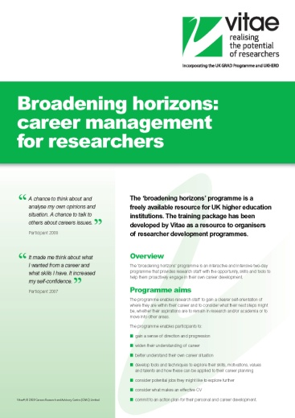

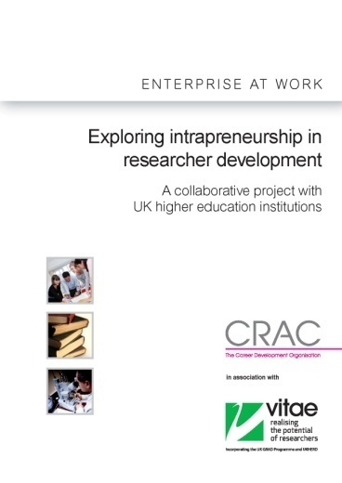
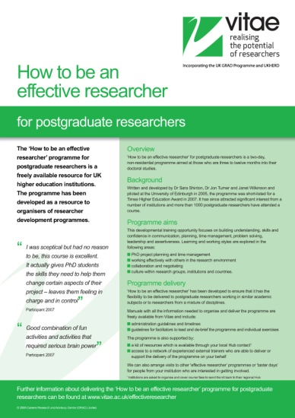

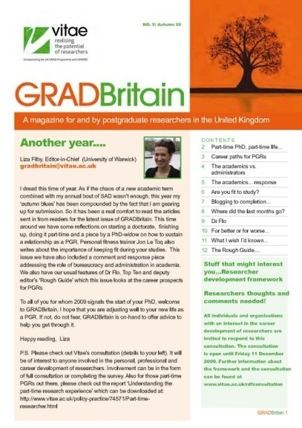
Vitae vision and aims
“For the UK to be world-class in supporting the personal, professional and career development of researchers”
Influence the development and implementation of effective policy relating to researcher development
Enhance provision in higher education to train and
develop researchers
Empower researchers to make an impact in their careers
Evidence the impact of professional and career development support for researchers
Notes:
2

Slide 3
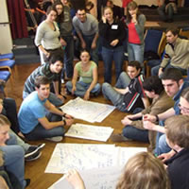
Vitae Researcher Development Framework
Common framework across institutions in the UK
Aid for planning, promoting and enhancing the professional and career development to researchers
Describes the knowledge, behaviours and attributes of successful researchers
Enables self-assessment of strengths and areas for further development
Universal language for communicating
researcher capabilities

Slide 4
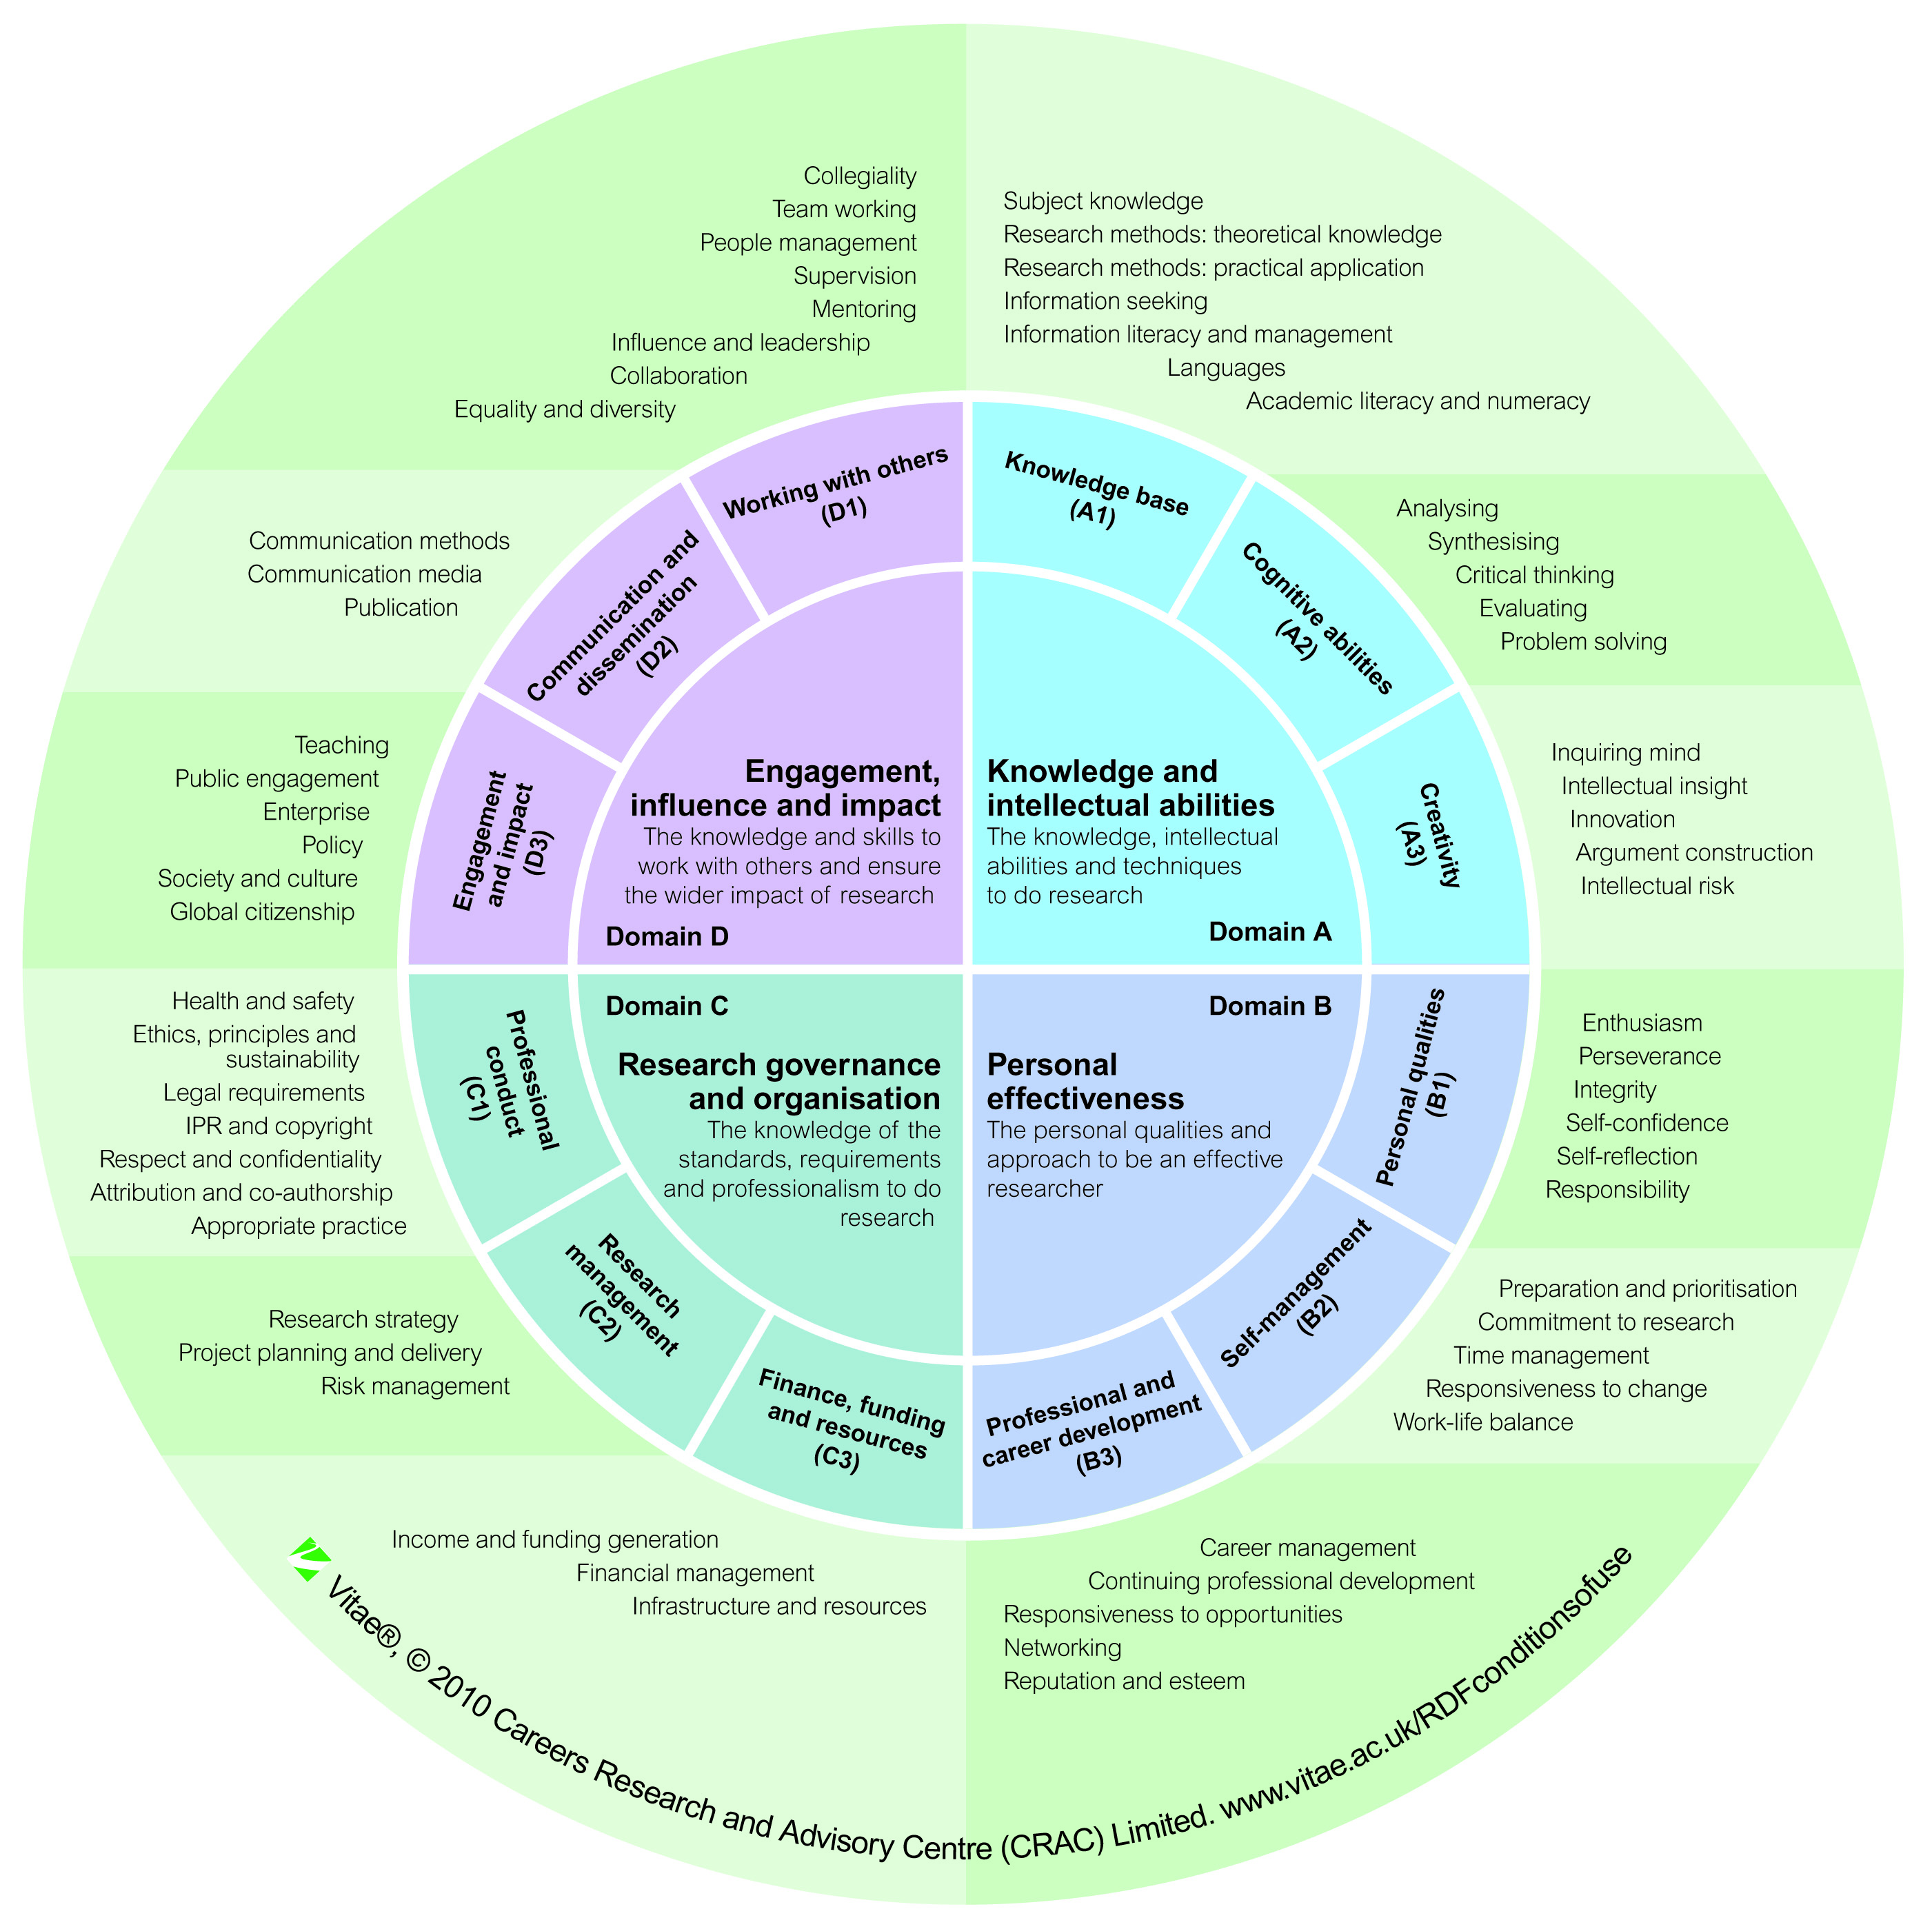
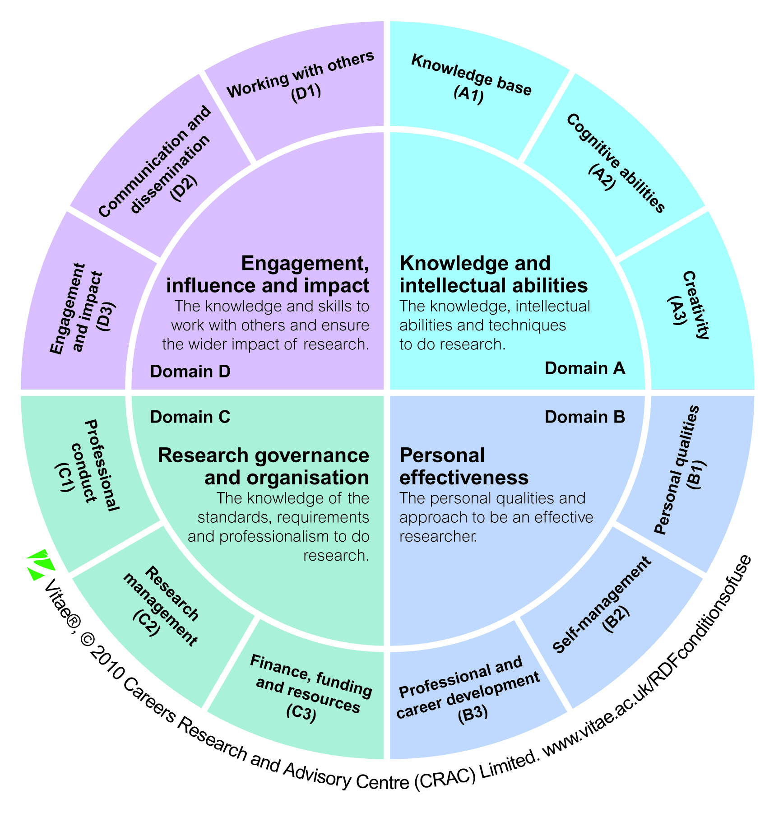

4 domains
12 sub-domains
63 descriptors

Slide 5
Development of the RDF
Designed by researchers for researchers
Framework informed by literature surveys and empirical data
>100 interviews with experienced researchers: range of experiences, institution types, geographical context, disciplines and demographics
>1000 characteristics and variants, clustered into common groups
Refined using feedback from specialist groups, sector-wide consultation, non-HE employers and validation with senior academics

Slide 6
Researcher Development Statement
The Researcher Development Statement (RDS) is the strategic statement of the RDF:
for policy makers and research organisations
endorsed by over 30 stakeholders including the Research Councils, QAA and the funding councils
an evolution of the Research Councils’ Joint Skills Statement (JSS)
The RDS and RDF together provide:
strategic statement (RDS)
operational framework (RDF)

Slide 7

Enterprise/Intra
Information Literacy
Teaching
Public Engagement
Leadership
Employability

Slide 8

What is a lens on the Vitae Researcher Development Framework
Using the RDF, a lens provides an overview of the key knowledge, behaviour and attributes developed by researchers
that can be acquired through, or used in, particular areas such as enterprise, information literacy, teaching etc
Two types of lens development:
Direct focus - Lenses derived from the Vitae Researcher Development Framework
Bridging/mapping - Lenses mapped to existing frameworks, set of professional standards or protocols

Slide 9
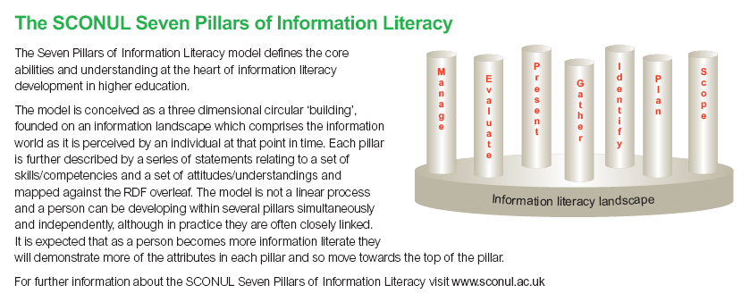
Society of College, National and University Libraries

Slide 10
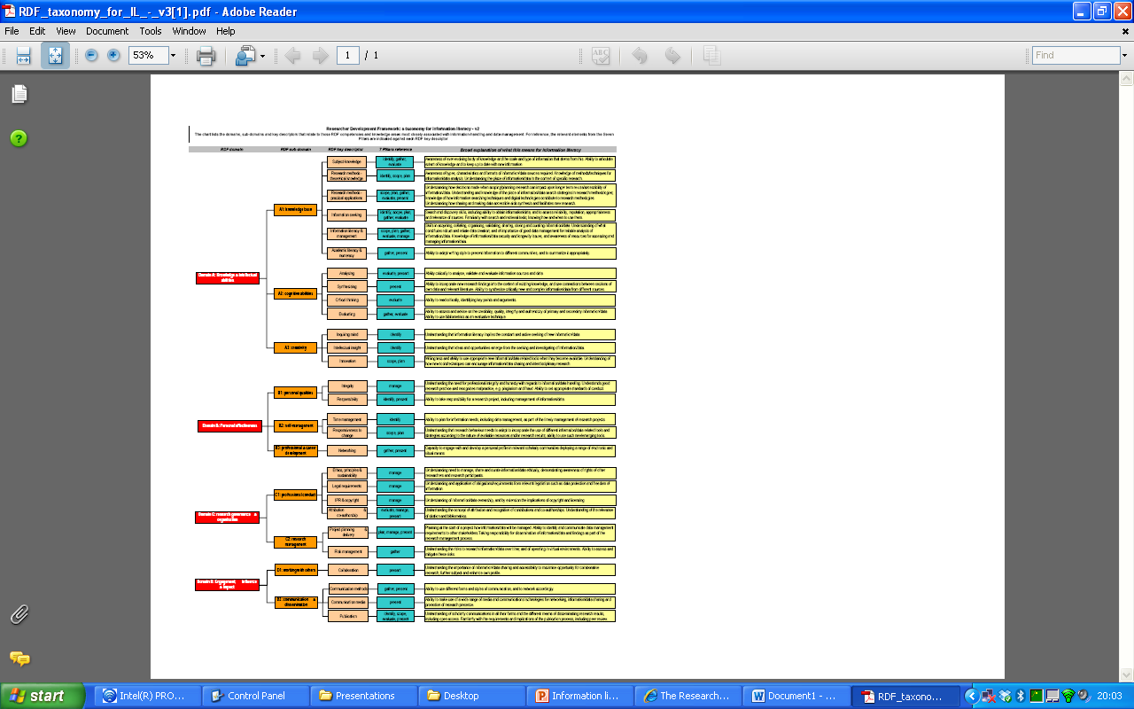
Information literacy taxonomy

Slide 11
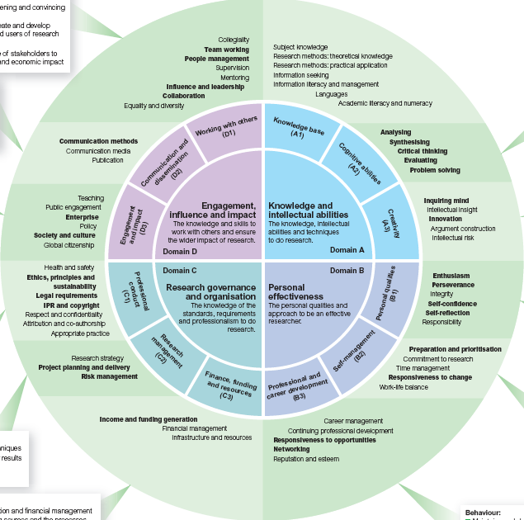
Information literacy lens
Expert development group (RIN, SCONUL, Vitae)
Validation with experts (Working group on information-handling)
Sector consultation

Slide 12
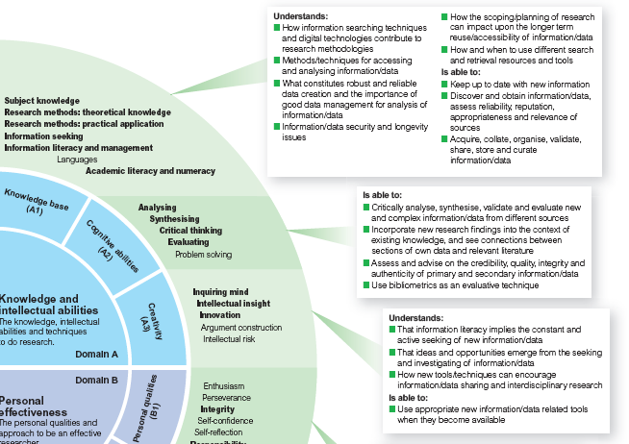
Information literacy lens

Slide 13
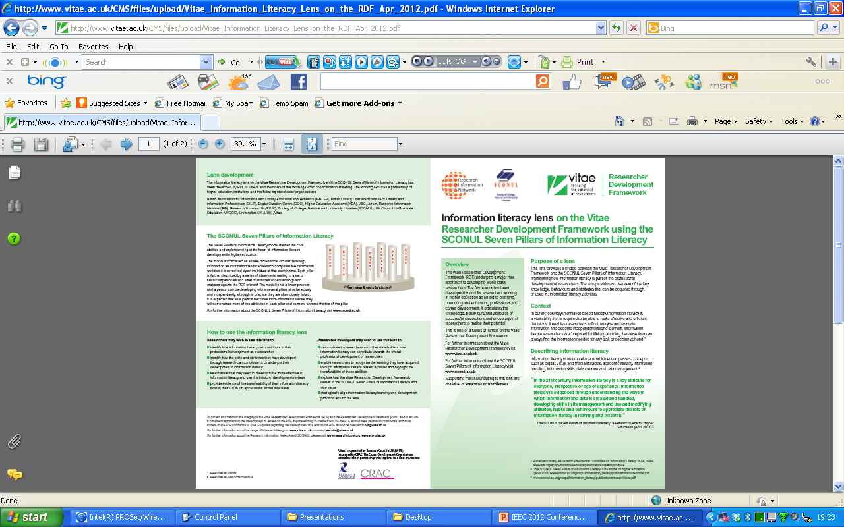
Information literacy lens

Slide 14
Using a lens
Researchers:
Identify how specific areas such as information literacy can contribute to their professional development as a researcher
Identify how the skills and attributes they have developed through research can contribute to, or underpin their development in those areas
Select areas to develop further
Provide evidence of transferability of skills
Notes:
14

Slide 15
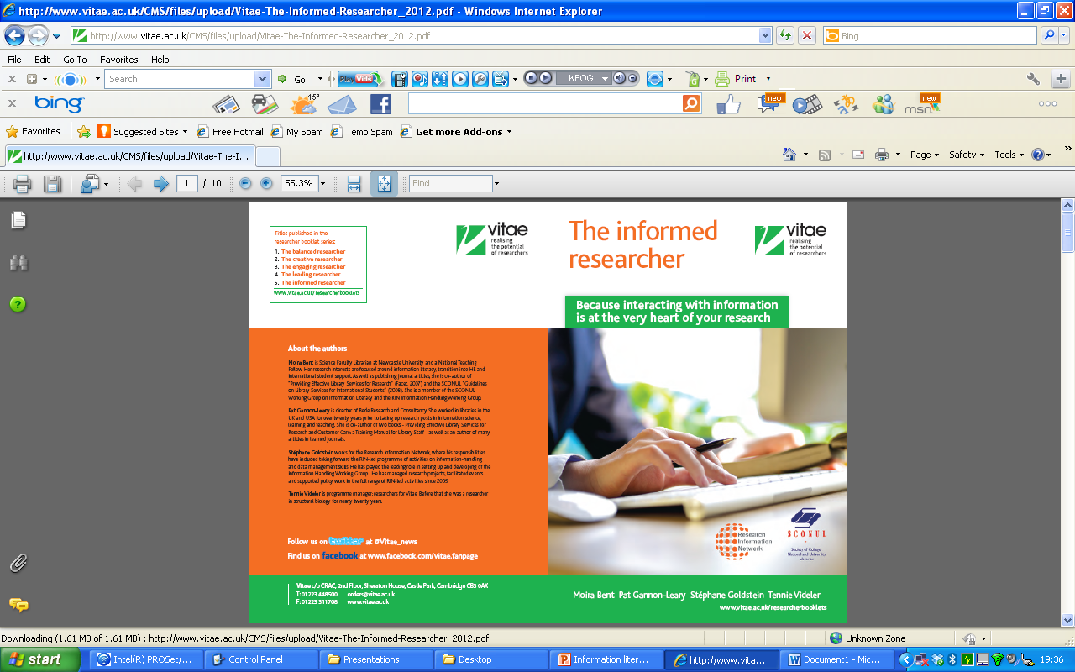
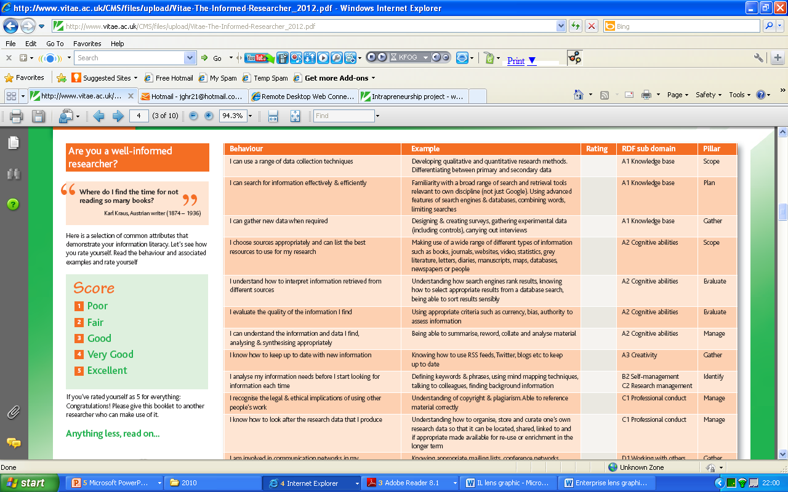
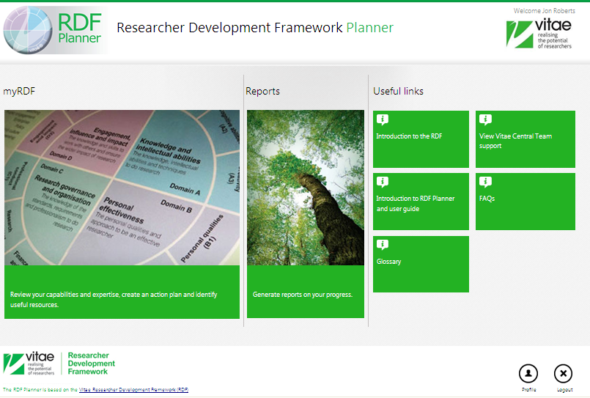

Slide 16
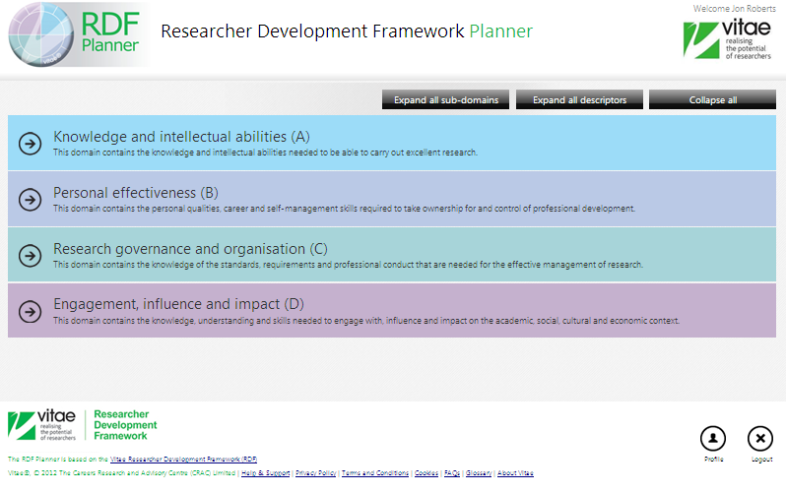
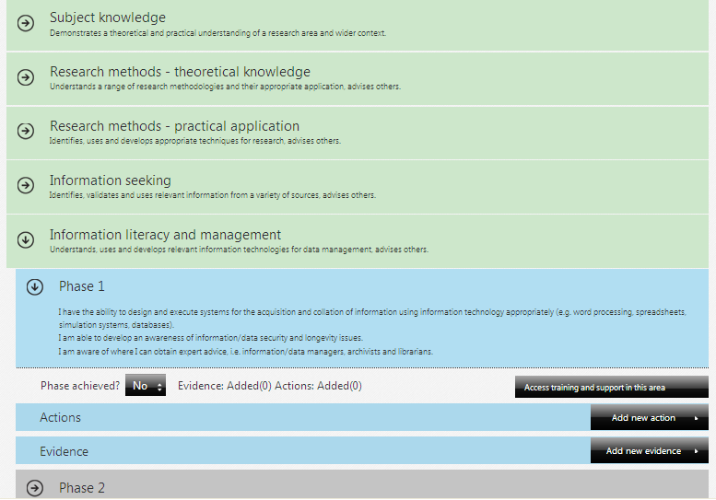
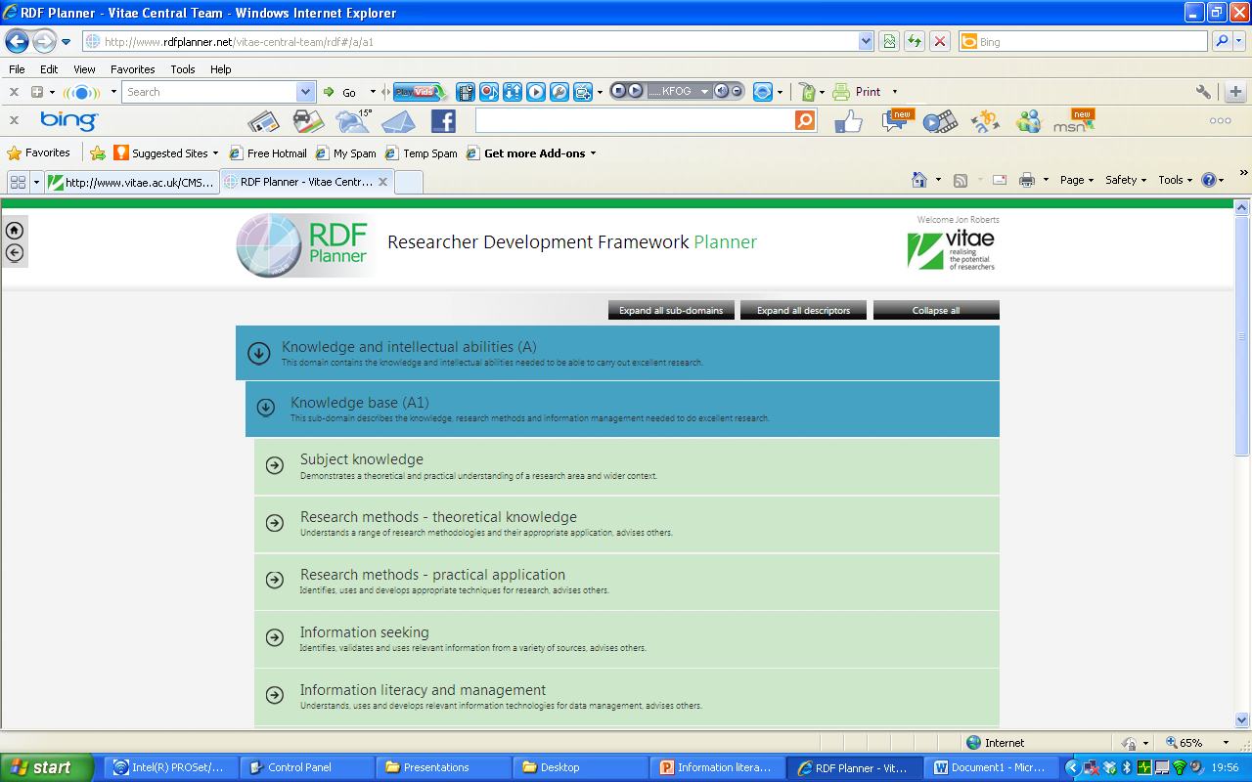
RDF Planner

Slide 17
Using a lens
Researcher developers:
Demonstrate to researchers how specific areas can contribute towards professional development
Enable researchers to recognise the learning they have acquired through particular activities
Explore how RDF relates to other frameworks and vice versa
Provide evidence of transferability of skills
Align learning and development resources around a lens
Notes:
17

Slide 18
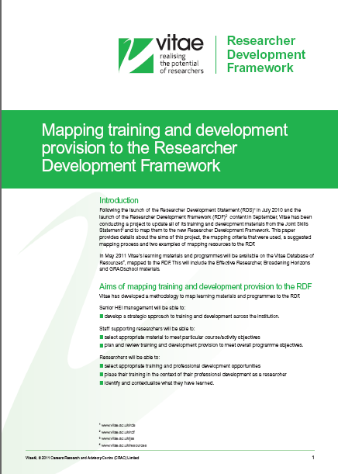
Mapping resources to the RDF
Resources should be mapped to the descriptor level of the RDF
Mapping can differentiate between ‘primary’ and ‘secondary’ outcomes
An upper limit of five primary and five secondary learning outcomes is recommended
Primary – outcomes likely to be achieved by all
participants irrespective of how the resource is
presented
Secondary – outcomes which might be achieved but to a lesser extent than a primary and might depend on how it is presented
Notes:
18

Slide 19
Mapping resources to the RDF
Focus on the participants' actual experience
Note knowledge, behaviours and attributes addressed (e.g gaining new knowledge, practicing a skill
Find the appropriate RDF domain for each one (ABCD)
Then the most appropriate sub-domain (e.g. D2 Communication and dissemination)
Then look at the key descriptors, with reference to their phase descriptions
Do guard against overcoding. Distinguish between ‘touching on’ and developing. E.g. just because the exercise involves working in a group, it is not necessarily developing teamwork understanding or skills
Notes:
19

Slide 20
DaMSSI – ABC: Database of Practice

Slide 21
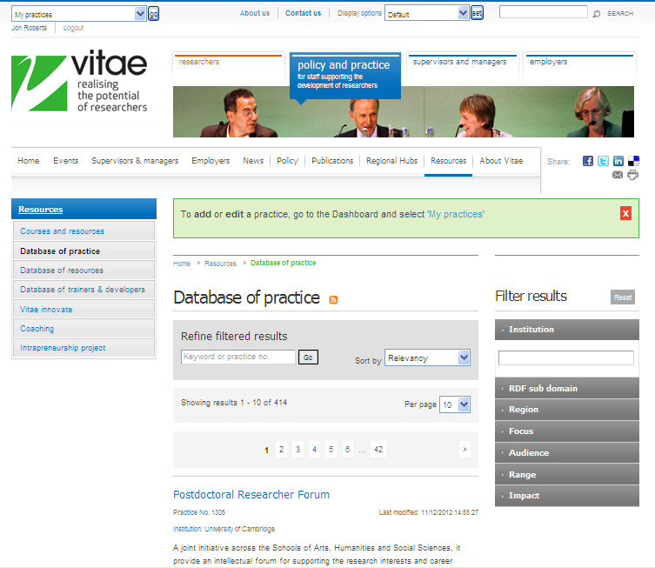
Database of Practice
Database that hosts over 400 examples of institutions’ professional and career development opportunities for researchers
A major way that HEIs share practice
A revised version of the database was launched in May 2011 aligned to the Vitae Researcher Development Framework
Notes:
21

Slide 22
Database of Practice
Registering to add a practice to the database
Adding an entry onto the database
Categories to complete for an entry
Outline
Owners
Categories (Relationship to RDF, focus, audience, range, impact, practice details)
Links and Documents
Conditions of use
Notes:
22

